Slide 1
NHC SUBMETERING SYSTEM
www.payless.cloud
www.riverton.co.tz
Measure|Manage|Evolve

Slide 2
ABOUT US…
With more than 10 years of experience operating smart submeters in this sector, condominiums, mobile homes, commercial buildings
We are the biggest private smart meters operators in Tanzania, with over 10,000 smart meters on site throughout Tanzania with powerful cloud Payless metering AMI engine.
We provide leading energy management solutions to all consumers of energy resources and utilities
We offer a tried-and-tested smart metering utility & asset energy bespoke software solutions.
Specialist smart metering Measurement and bill Verification Services.

Slide 3
SUBMETERING CONCEPT…
Utility submetering is a system that allows landlord on multi-tenant building to bill tenants for for individual measured utility usage.
Landlord DO NOT sale electricity, he recovers/collection of the funds for the used/to be used utilities
Each tenant in the building will be measured separately on prepaid or postpaid basis
Tenants are refunding landlord the costs of the utility used in their areas
The collected funds will be used by the landlord to pay the Utility company bill
Instead of the process to be manual, submetering companies automated the process to help the landlord

Slide 4
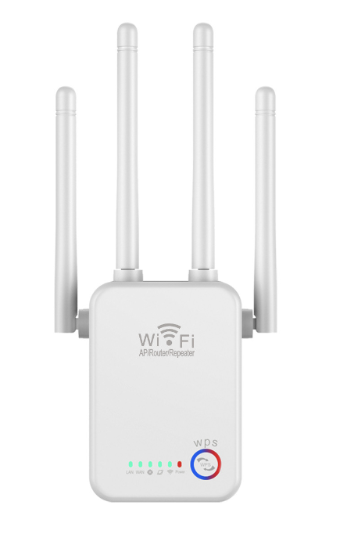
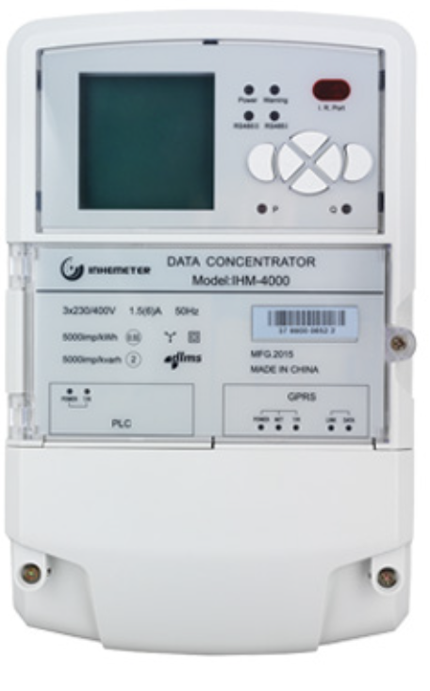
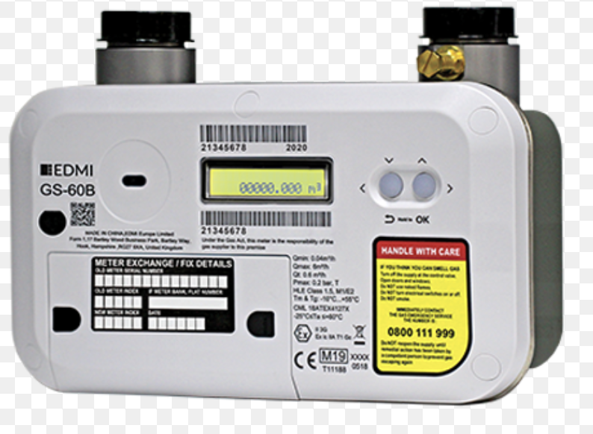
HARDWARE LAYER…
It is the primary layer consisting of:
Meters
DCUs
Gateways
Repeaters
Routers
etc
Meters are the ones measuring utility on prepaid/postpaid fashion.Gas,Electricity,Water,Doors and HVAC
DCUs : Data Concentrators
Gateways : Internet gateways with GSM,lorawan,etc capabilities
Repeaters : wireless signal energizers to reach further meters
All are easy to procure and install and configure from any manufacturer

Slide 5
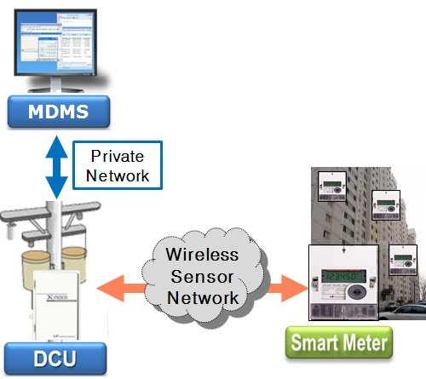
SOFTWARE LAYER…
The whole Software ecosystem to manage and process the whole submetering infrastructure
It is called AUTOMATIC METERING INFRASTURECTURE (AMI)
It is the ”processor” and controls everything
Nowadays, no standalone softwares setup anymore
Only, cloud based
No need for landlord to own it or to have one

Slide 6
CLOUD SOFTWARE...
Important Users:
Financial/Audit Expert(HQ)….A
Director/Head of Real Estate (HQ)….B
Building Manager (Site)……C
Token Seller (Cash) (Site)…..D
Installers/Maintenance Fundis(Site)….E
Tenants(Site/Anywhere)…..F
Two Software Systems
Main
Backup
Three servers locations
Tanzania…primary
UK….backup 1
US…backup 2
When everything goes down in all countries:
Automatic Bank of 1000 scratch cards for each meter in different denominations(5,000,10,000,50,000 and 100,000) will be given to Building managers manually/emails

Slide 7
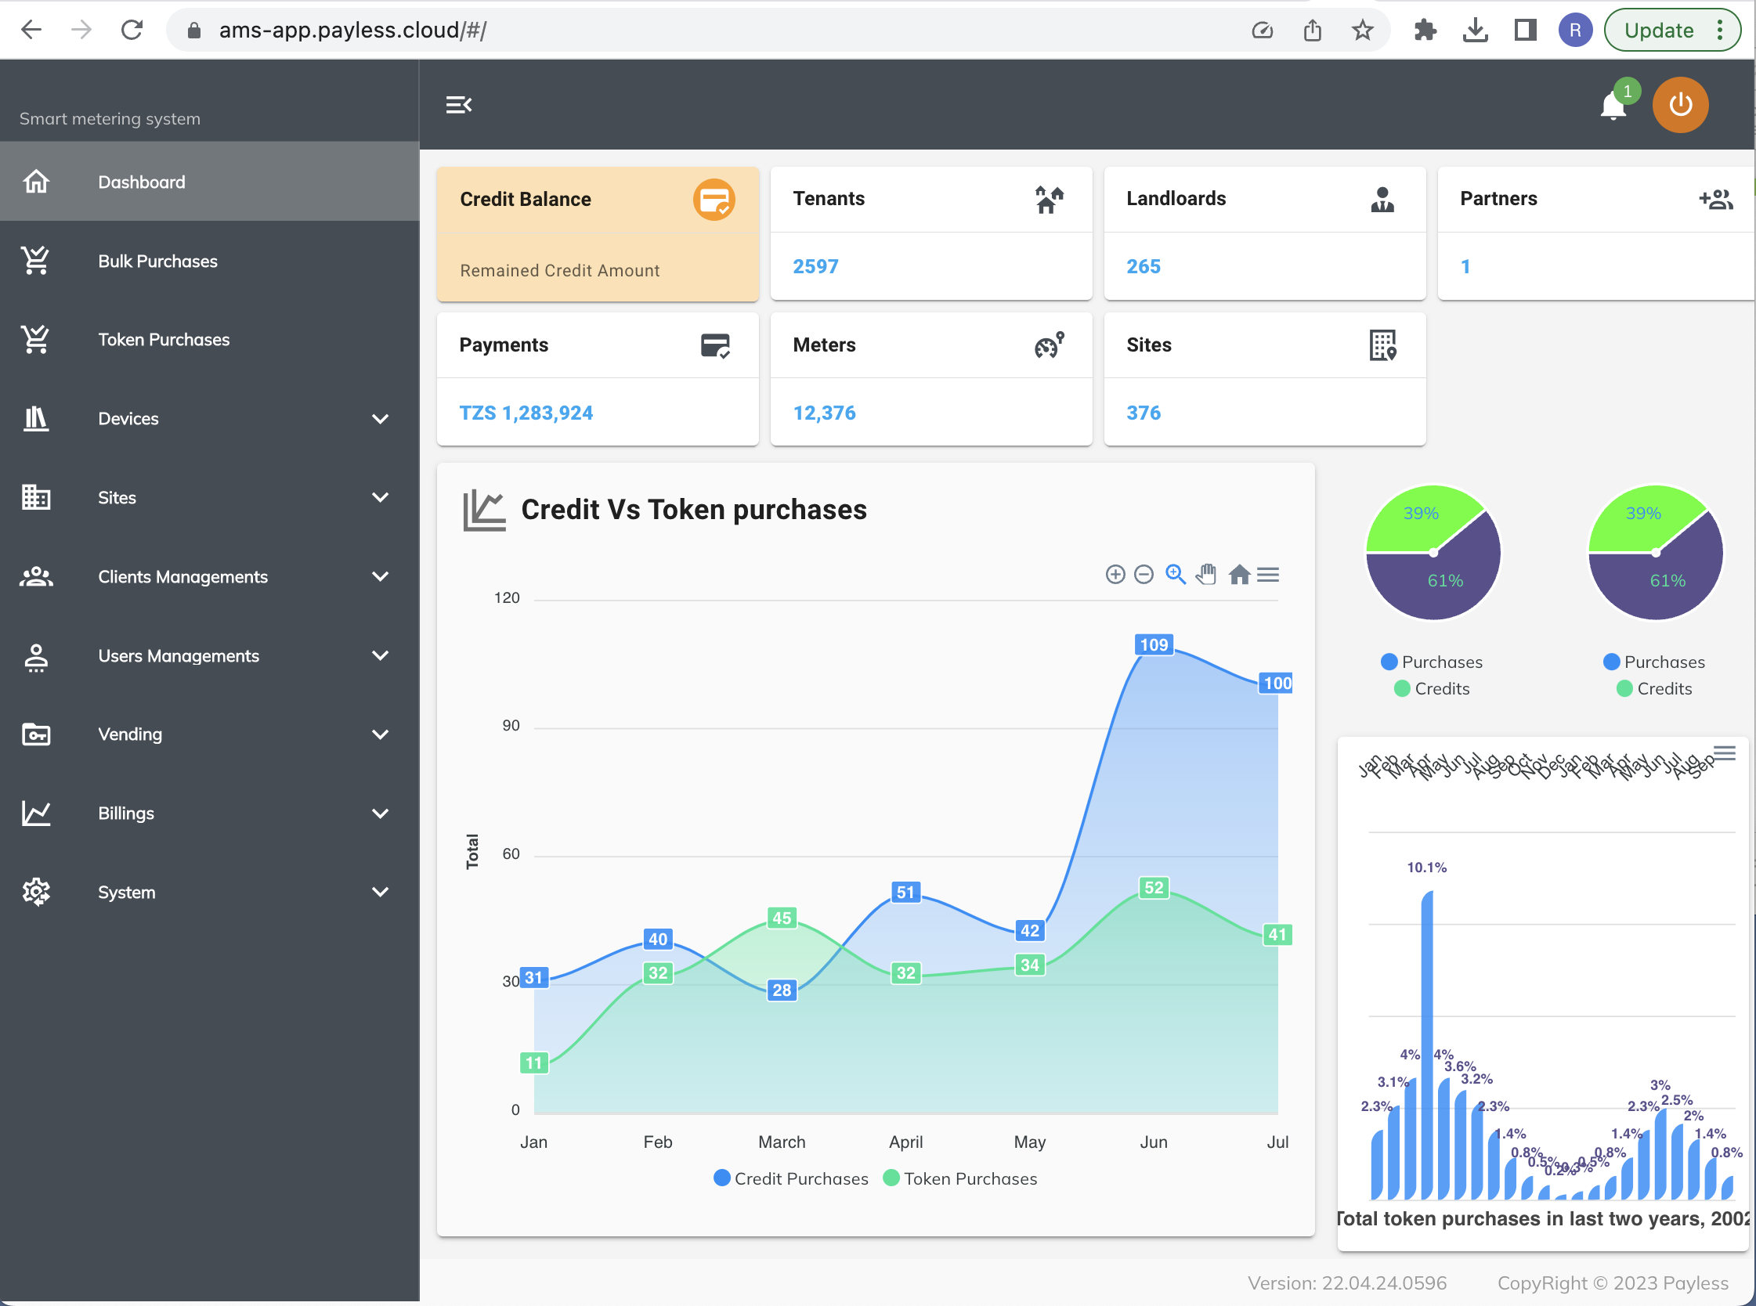
CLOUD SOFTWARE...
Main Software System….

Slide 8
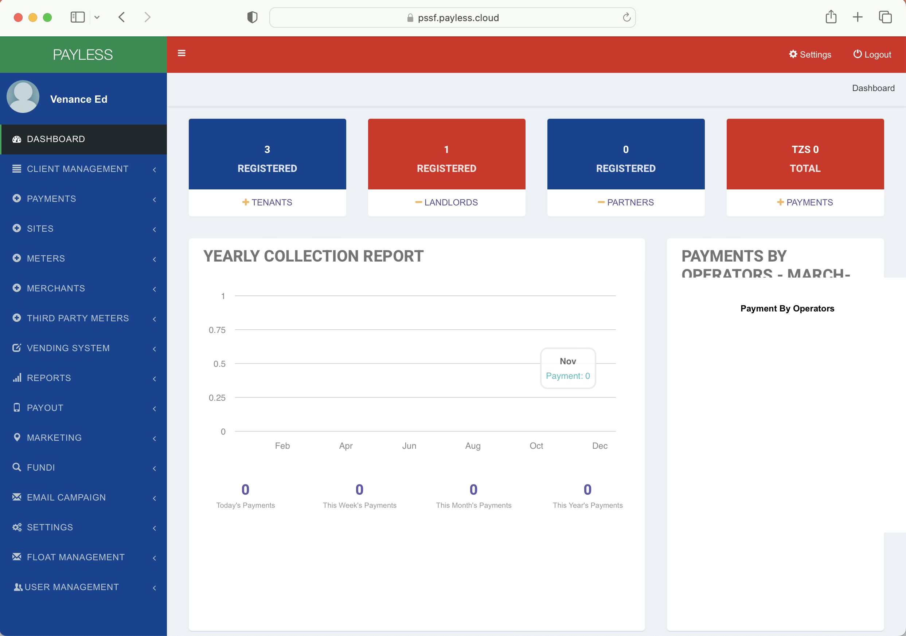
PSSSF CLOUD SOFTWARE...
Back Software System….

Slide 9
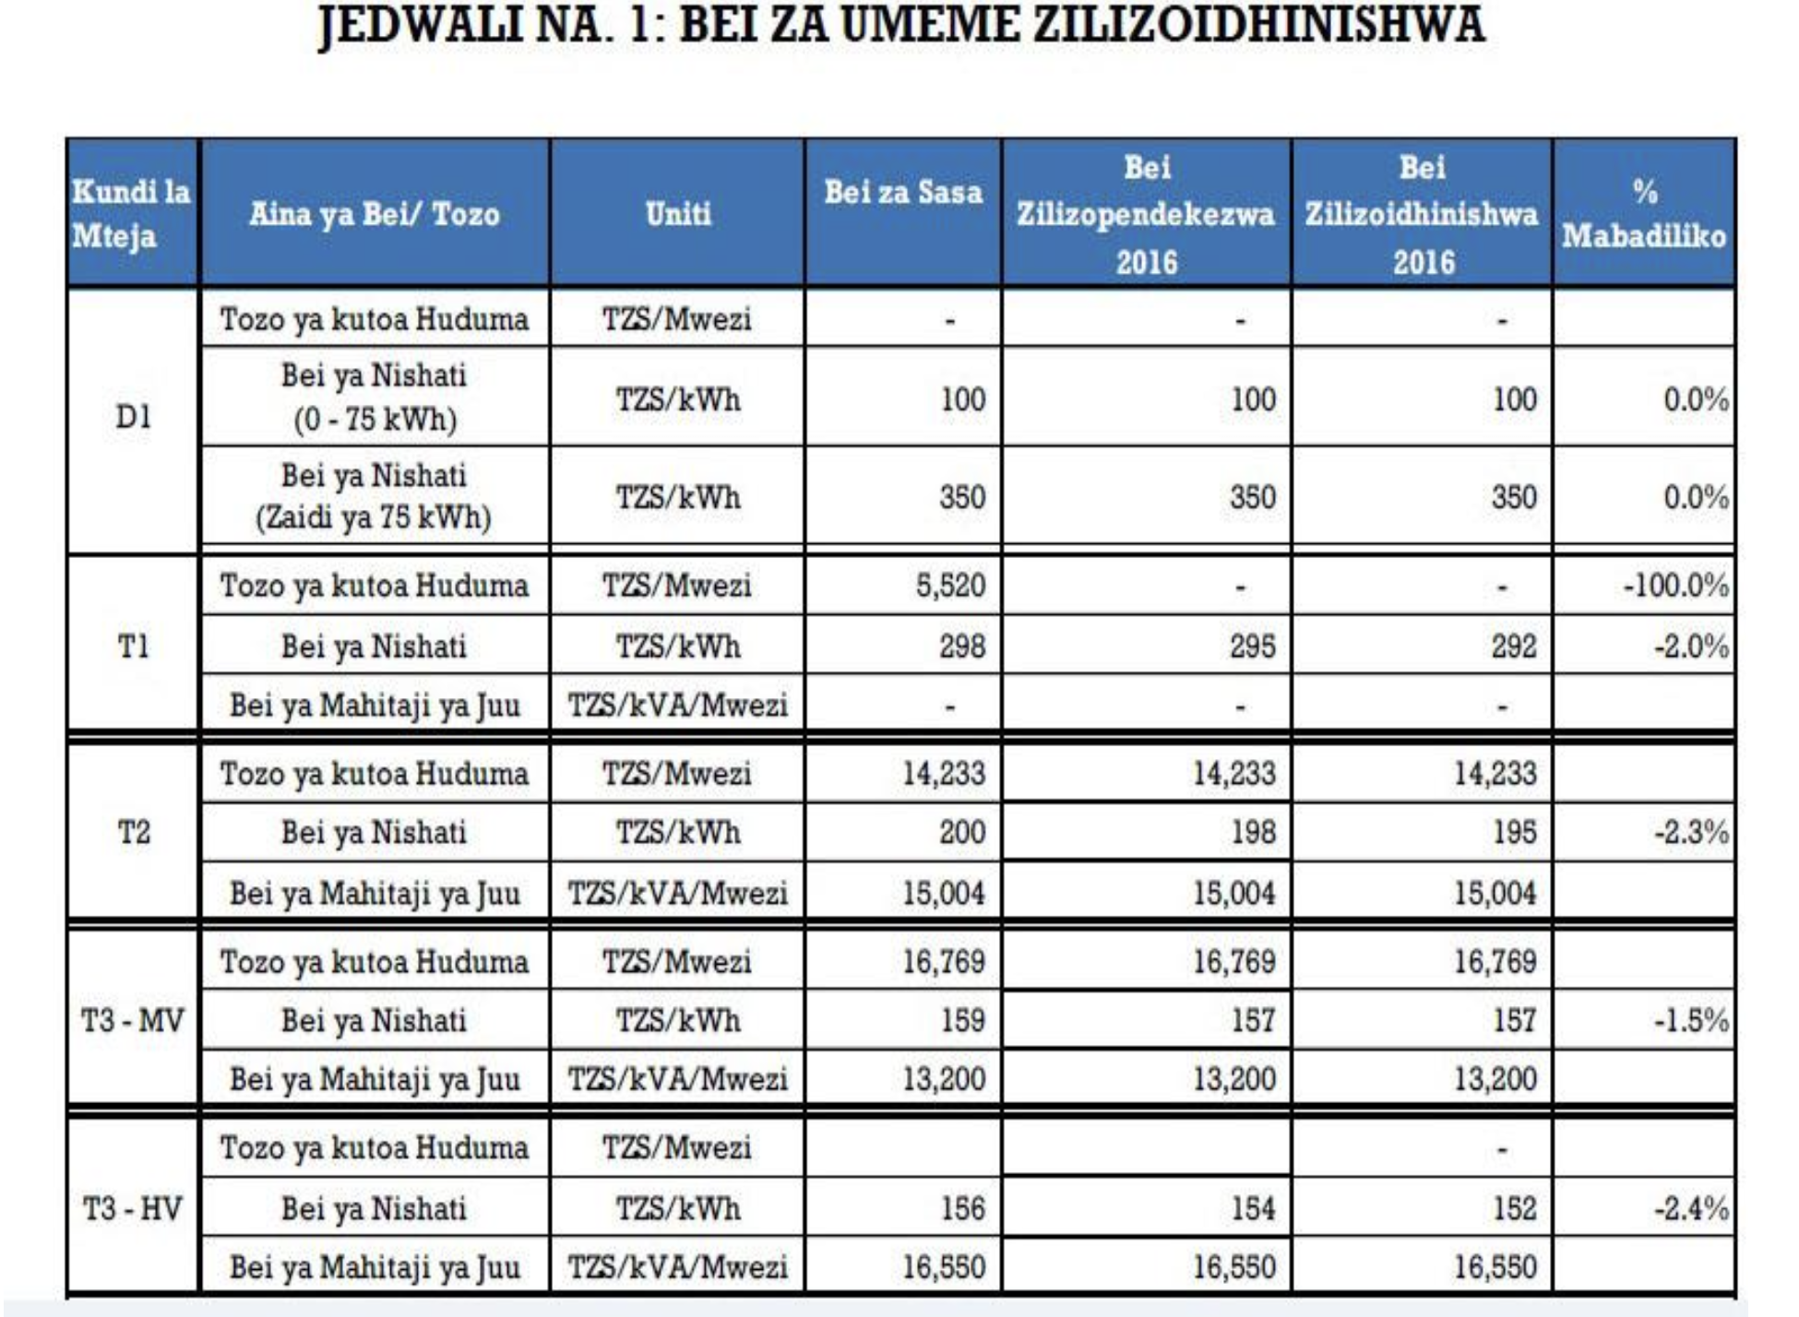
PROPOSED ELECTRICITY DISTRIBUTION TO TENANTS…
Things to know…..
Electricity and water prices are government’s prices, not yours!
Important to Adhere:
1.Lifestyle----Cover Holes
2.Super Automate-----Dont Depend on Human Mercy
3.Decentralize Works/Majukumu----Centralize Financial System
You are not a utility company, you are a landlord collecting utility costs from your tenants (automatically)!

Slide 10
PROPOSED ELECTRICITY DISTRIBUTION TO TENANTS…
Cont….
A
D
Normal Periodic Collection and Submission by Bank Transfers
Daily
Weekly
Monthly
Cash
PSSSF receives cash from tenant
Prints token manually
SMS+Physical Receipt
B
E
Prepaid Float Method
Riverton present to buy bulk electricity float from PSSSF
PSSSF Accepts/Decline and generate Control Number for payments
Riverton/distributor present proof of payment to PSSSF
PSSSF approves, then float credits to Riverton float wallet
Riverton/distributor distributes to tenants until 0
At 0,electricity stops, new float is needed
Total Managed Utility Billing Processes
PSSSF completely outsource billing collection from tenants and then repayments to Tanesco
Riverton/Manager/Agent collects all the billing costs of the building from tenants
Riverton/Manager/Agent repays all the utility bills for the managed PSSSF Buildings
PSSSF will not be accountable of anything
C
GePG
PSSSF will contact GePG with the collection issue
Tenants will buy from GePG phone front ends..meter number/amount
GePG will connect with Riverton API for token generation
Token and tenant’s details back to GePG to deliver to tenant’s phone
****THIS IS WHAT GOVERNMENT REQUIRES****
By the law, all govt agencies’ e-payments/mobile should pass through GePG (seek advice consult GePG)

Slide 11
PROPOSED SUBMETERING MANAGEMENT PLAN…
Payless Cloud AMI
NO PLATFORM FEES FOR LESS THAN 2,500 METERS INTO THE SYSTEM
MIGRATION TO ANOTHER PROCESSOR WILL BE PROVIDED WHENEVER NEEDED

Slide 12
UNIFIED SUBMETERING COMPARTIBILITY/STS COMPLIANCE…
Unified Meter Management
All meters from all manufacturers across the world measuring any kind of utilities used by one customer(PSSSF) are managed in one place.
Electricity,water,gas,doors,AC,etc
All Manufacturers across the world
Liberate customer to be free to buy meter from anyone
To avoid manufacturers/suppliers traps
All financial and meters data from one point
Security and inter-operability is guaranteed 100%
Security Issue
The use of advanced encryption techniques, which are at all times hidden from the consumer - the system is easy to use.
The use of very secure key management procedures, including the manner in which keys are generated and transported.
The required security functionality at both the vending station and the meter.
STS Association
Interoperability Issue
Ensuring that manufacturing members make encryption keys available to other manufacturers at the request of the utility using the equipment;
Accrediting and maintaining a list of equipment test laboratories which ensure correct STS functionality of equipment;
Ensuring consistent and unique manufacturer identity codes and meter serial numbers
The Standard Transfer Specification (STS) describes a secure message system for carrying information between a point-of-sale and a meter, and is currently finding wide application in electricity metering and payment systems.
ALL METERS YOU BUY OR OPERATE SHOULD COMPLY WITH STS FOR YOU TO BE FREE OTHERWISE YOU ARE DOOMED

Slide 13
FUTURE SUBMETERS TO IMPLEMENT…
Things to know
3.RENT DOOR METERS/LOCKS
You already have a unified software infrastructure
Buy from any manufacturer, supplied and installed by anyone
Must be STS certified
Can buy from us,Israel made,better than Chinese,STS,warrant 3 years.
Time based rent sessions for tenants
When rent is due,the door locks
Just buy meters and install and register in the system
Same software processing electricity meters, process everything else
1.Water Meters
Buy from any manufacturer, supplied and installed by anyone
Must be STS certified
Wells and Dawasa water will be repaid with profit
Can buy from us,western made,better than Chinese,STS,warrant 3 years.Revenues from Kisima can repay meter cost in a year
4.HOME GAS METERS
Buy from any manufacturer, supplied and installed by anyone
Must be STS certified
Can buy from us,western made,better than Chinese,STS,warrant 3 years.
For high end tenants who wants centralized gas systems
2.HVAC
Buy from any manufacturer, supplied and installed by anyone
Must be STS certified
Can buy from us,US made,better than Chinese,STS certified
Time based AC sessions
Chiller costs will be recouped back
ONLY ELECTRICAL METERS CAN BE BOUGHT FROM CHINA
WATER/HVAC/LOCKS SHOULD BE BOUGHT FROM THE WEST
Reason being electrical meters are simple to make,others are complex and need durability, China do not cut it

Slide 14
OUR PRESENSE IN TANZANIA….
More than 10,000 Domestic Houlseholds in Tanzania

Slide 15
CONTACTS…
Let us improve your Buildings smart
energy advantage!
Head Office:
Plot No. 12,Block J, Mbezi BeachArea
New Bagamoyo Road,Riverstate House
Dar es Salaam,TANZANIA
Tel:+255(0)222618777
Fax:+255(0)222618778
Cell:+255(0)654717644
For Quotations (RFQs):
Contact Persons:
Miss Irene Silverster Mmbando
Email: irene@payless.co.tz
Cell:+255(0)654717644
General Information Inquiries:
Tel:+255(0)222618777
Fax:+255(0)222618778
Email:info@payless.co.tz
Website:www.payless.co.tz
Call Centre:
Hotline: 0222618777

